Slide 1

Soccer Data Analysis Using Data Warehouse
Presented By:
Dibya Darshan Khanal (1708407)
Liza Amatya (1681638)

Slide 2
Project Overview
Usage of Data warehouse – Apache Doris
Apply data mining techniques to uncover hidden insights within the soccer datasets
Clean and preprocess diverse football datasets (CSV, JSON, SQLite)
Standardize data into a common format
Load structured data into Doris databases for efficient querying and analysis
Integrated Visualization tool - Apache Superset

Slide 3
Tools Used
Apache Doris
Amazon Web Services
AWS EC2 (Ubuntu)
AWS S3
Apache Superset
Scripting and Querying
Python
SQL
YAML
GitHub: https://github.com/LizaAmatya/SoccerDataAnalysis

Slide 4
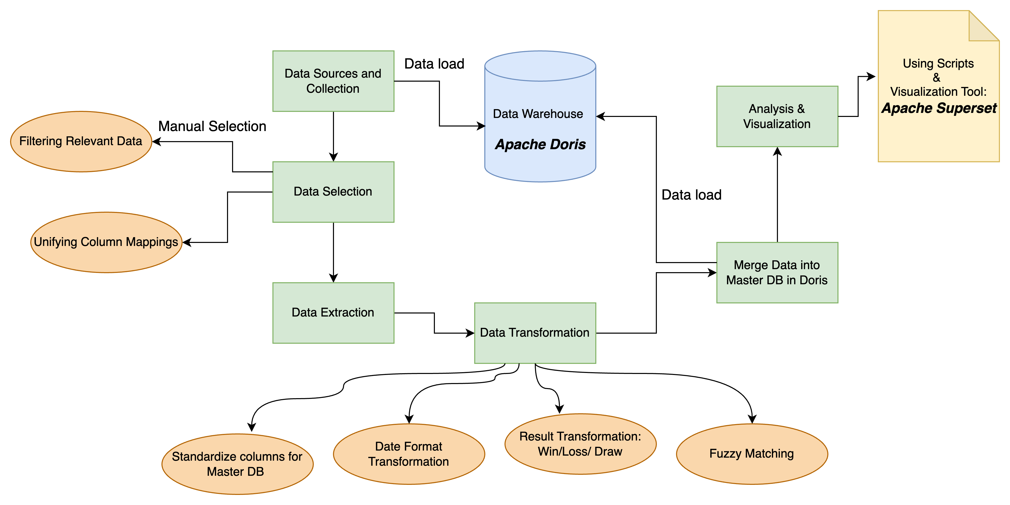
Methodology
Notes:
Data selection – based on club data rather than country based, matching common cols like: home score, away score data in different dbs Data transform : fuzzy matching eg.: col naming convention – FTHG/ FTAG – HomeScore, AwayScore, changing reserved keyword naming like renaming: Match to Matches

Slide 5
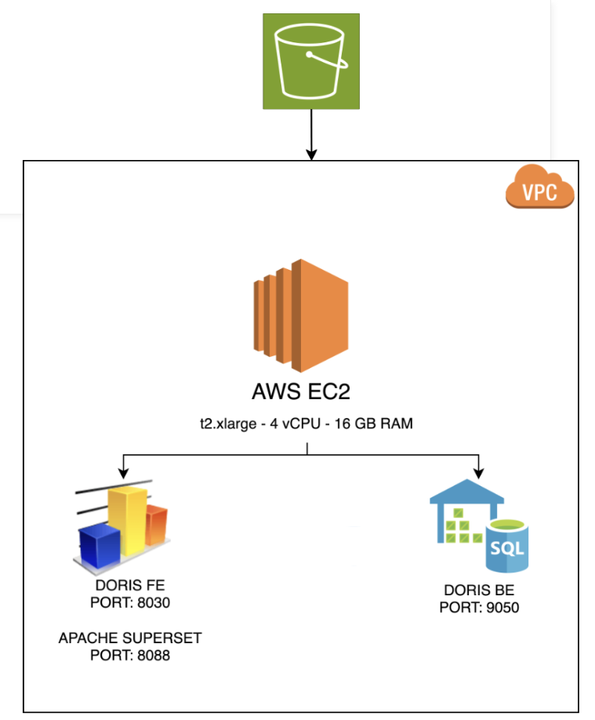
Cloud and System Automation
Apache Doris FE & BE on EC2
RAM: FE (8GB), BE (16GB)
FE URL: http://18.223.11.133:8030/
S3 to store datasets, backups and csv files
Setup Steps:
Installed Java, GCC, Python 3.10, and configured disk partitions
Edited priority networks, added backend via ALTER SYSTEM command
Security: Stream load auth with root + GRANT commands
Virtualenv setup to isolate Python 3.10 for Superset stability.

Slide 6
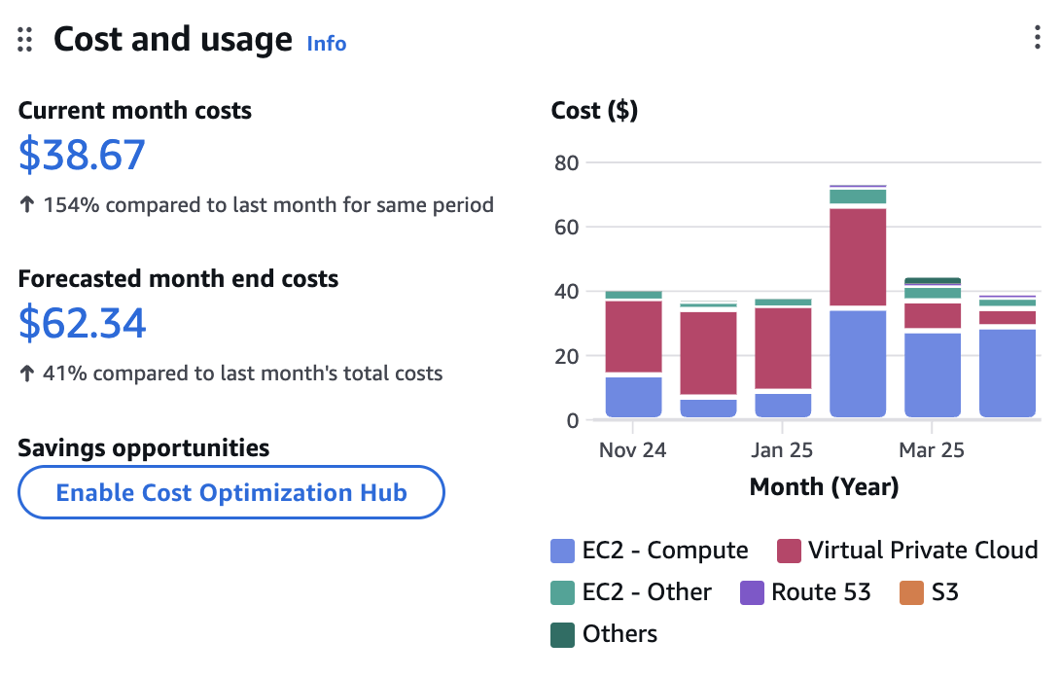
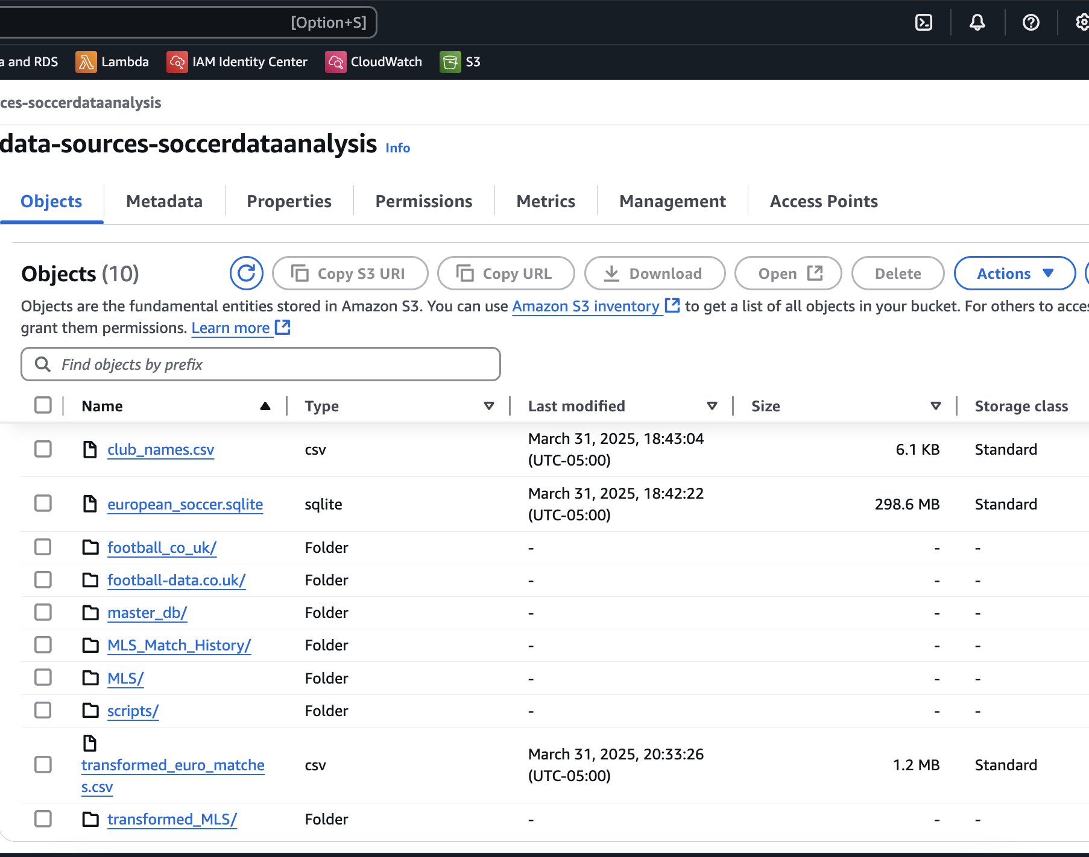
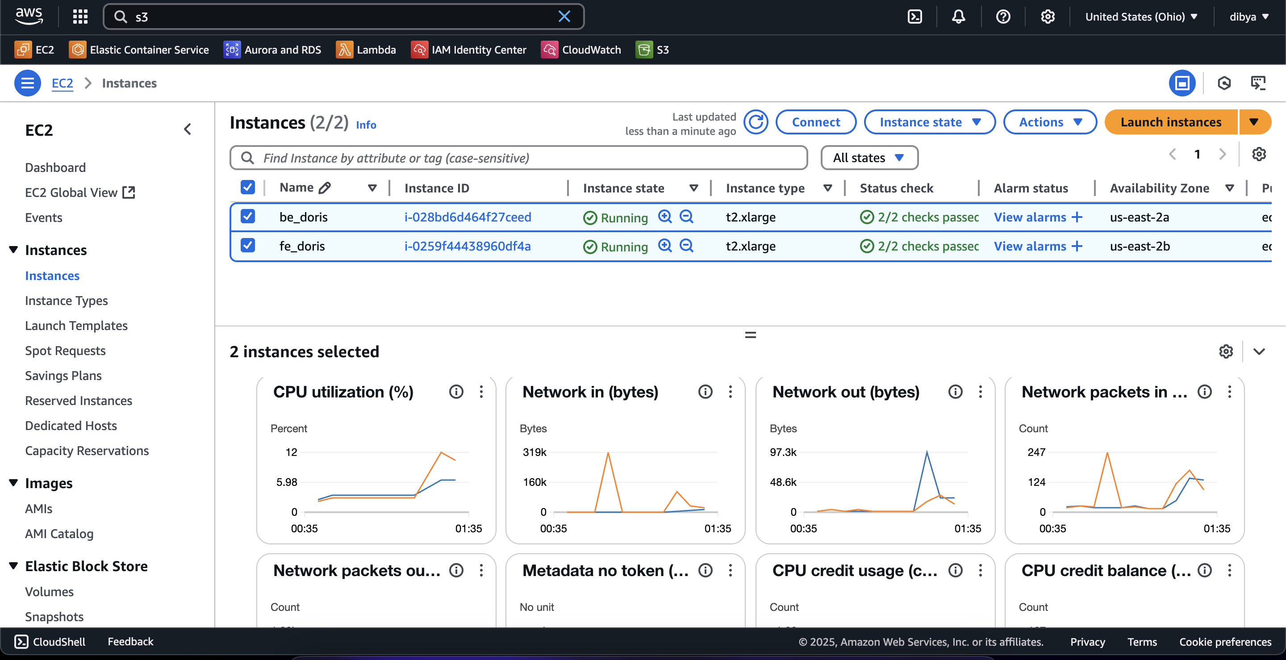
AWS Configuration

Slide 7
Data Collection
Sources:
Kaggle Soccer History Dataset
Football-data.co.uk (FTR format)
GitHub: UEFA game matches (JSON)
Selection Strategy: Chose consistent club data over inter-country games for uniformity
Selection: Manual selection of relevant columns across datasets

Slide 8
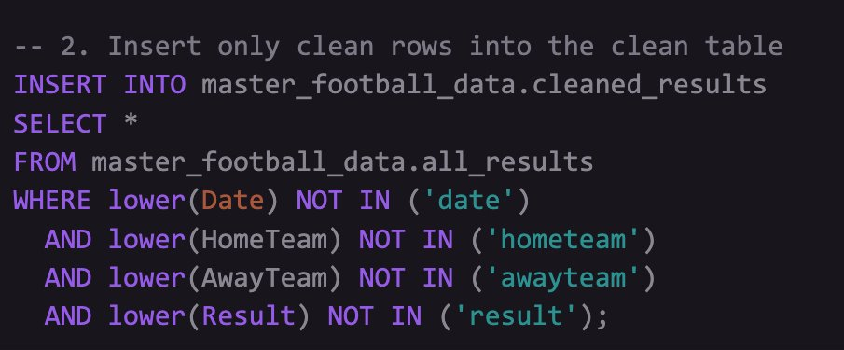
Data Cleaning
Renamed Doris reserved keyword column names like: "match" --> "matches"
Removed junk rows from GitHub CSVs using regex filtering before loading into Doris.
Excluded non-numeric and mislabeled rows to ensure only valid match records were loaded into the warehouse.
Eg. Data Cleaning using Query

Slide 9
Data Loading
Utilized Doris stream_load API to ingest datasets efficiently from CSV files using Python scripts
Supported both local and S3-based data sources, allowing flexible data ingestion pipelines
Dynamically created database tables based on S3 paths
Applied preprocessing steps such as null handling, unification, and field-level transformation prior to loading
Doris Database generated:
euro_soccer
MLS_Match_History
football_co_uk
master_football_data – all_results , cleaned_results

Slide 10
Data Transformation
Fuzzy matching: Mapped team name variants to standard names like: "MANU", "Man Utd" --> "Manchester United". Similarly for other clubs: FC Barcelona, Bayern Munich, etc.
Standardized Column names that had different columns but meaning same across datasets. Eg. : FTHG / FTAG -> home goal / away goal
Date format transformation: Converted to format: "2008-07-12"
Replaced foreign key references or numeric IDs with actual team names
Some datasets lacked an explicit result field and only provided scores. In such cases, the match outcome was derived from the home and away scores. Others used inconsistent labels like Win/Loss/Draw.
All results were normalized to a consistent format: Home / Away / Draw

Slide 11
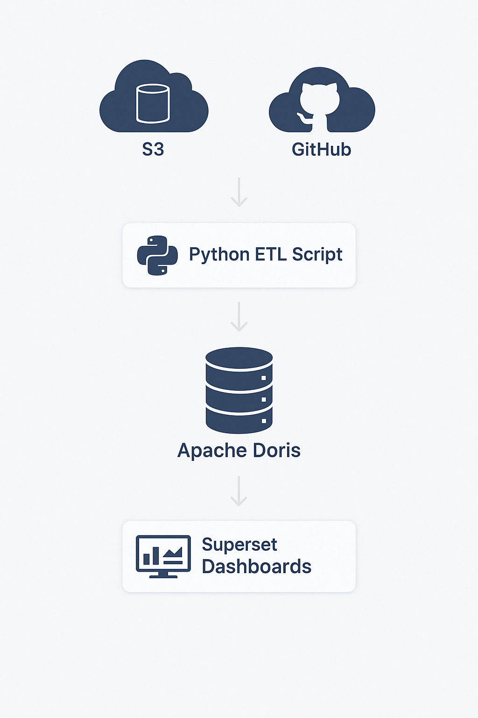
ETL Pipeline Overview
Extract: Loaded data from multiple formats (CSV, JSON, SQLite) from S3 & GitHub.
Transform: Unified different schemas using fuzzy column matching and standard mapping (home_team, result, etc.).
Load: Pushed clean datasets into Doris using Python + Doris stream_load API.

Slide 12
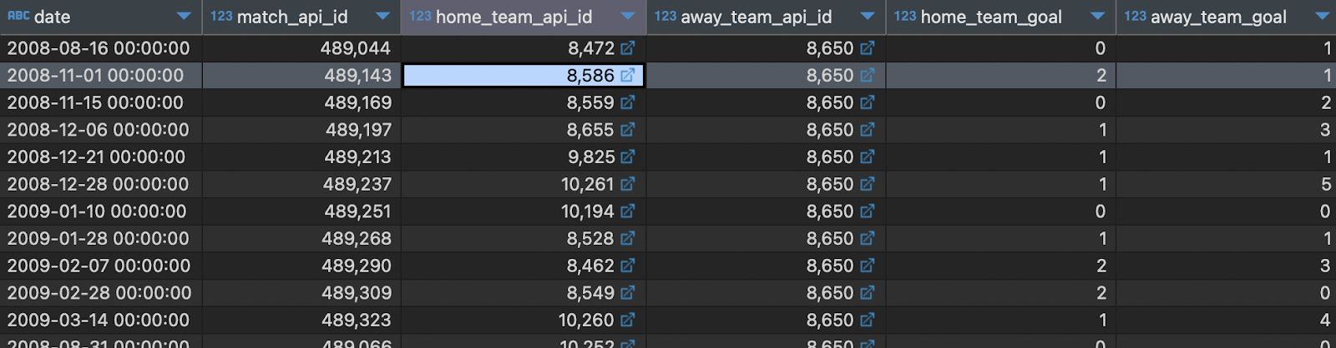
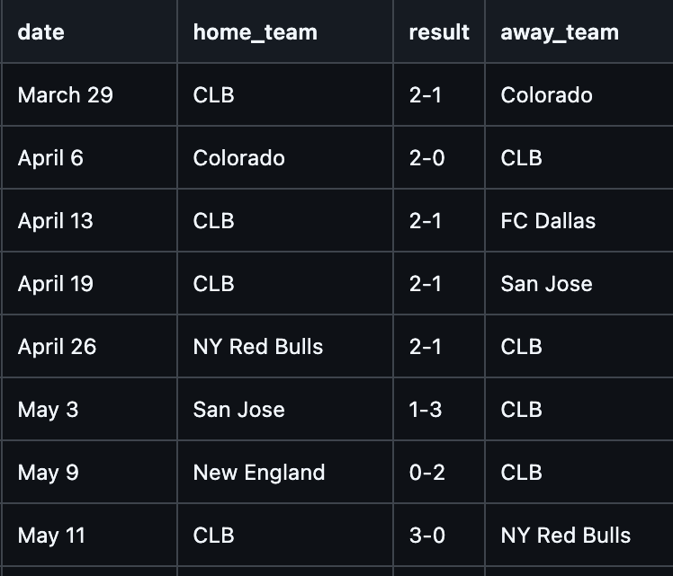
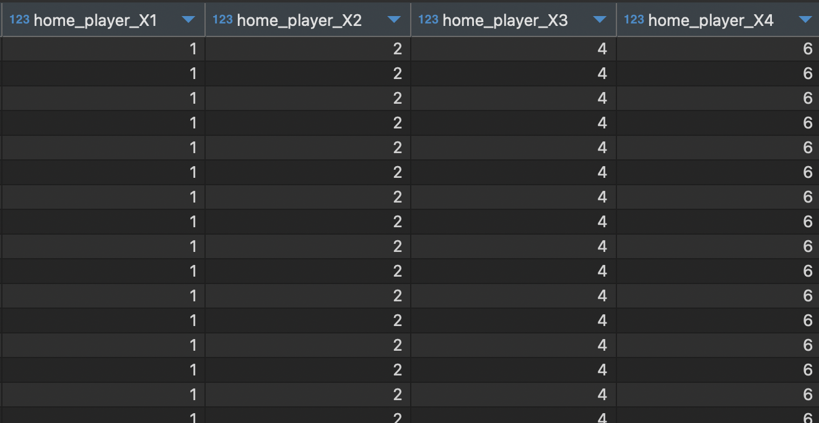
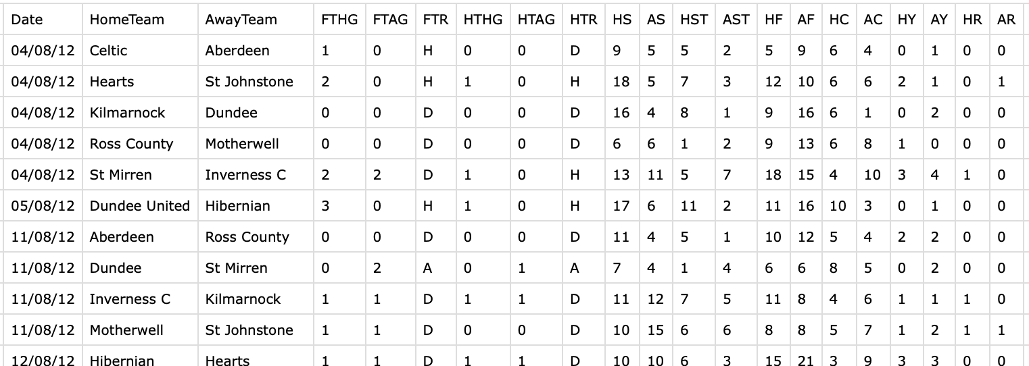
Data Transformation – Multiple Source Data

Slide 13
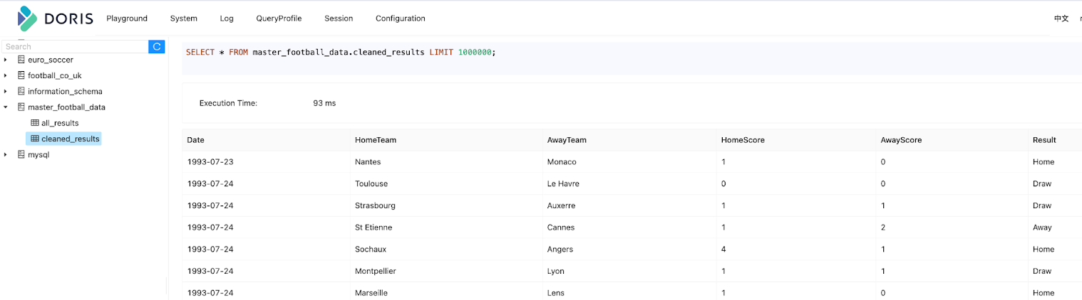






Data Transformation – Master DB

Slide 14
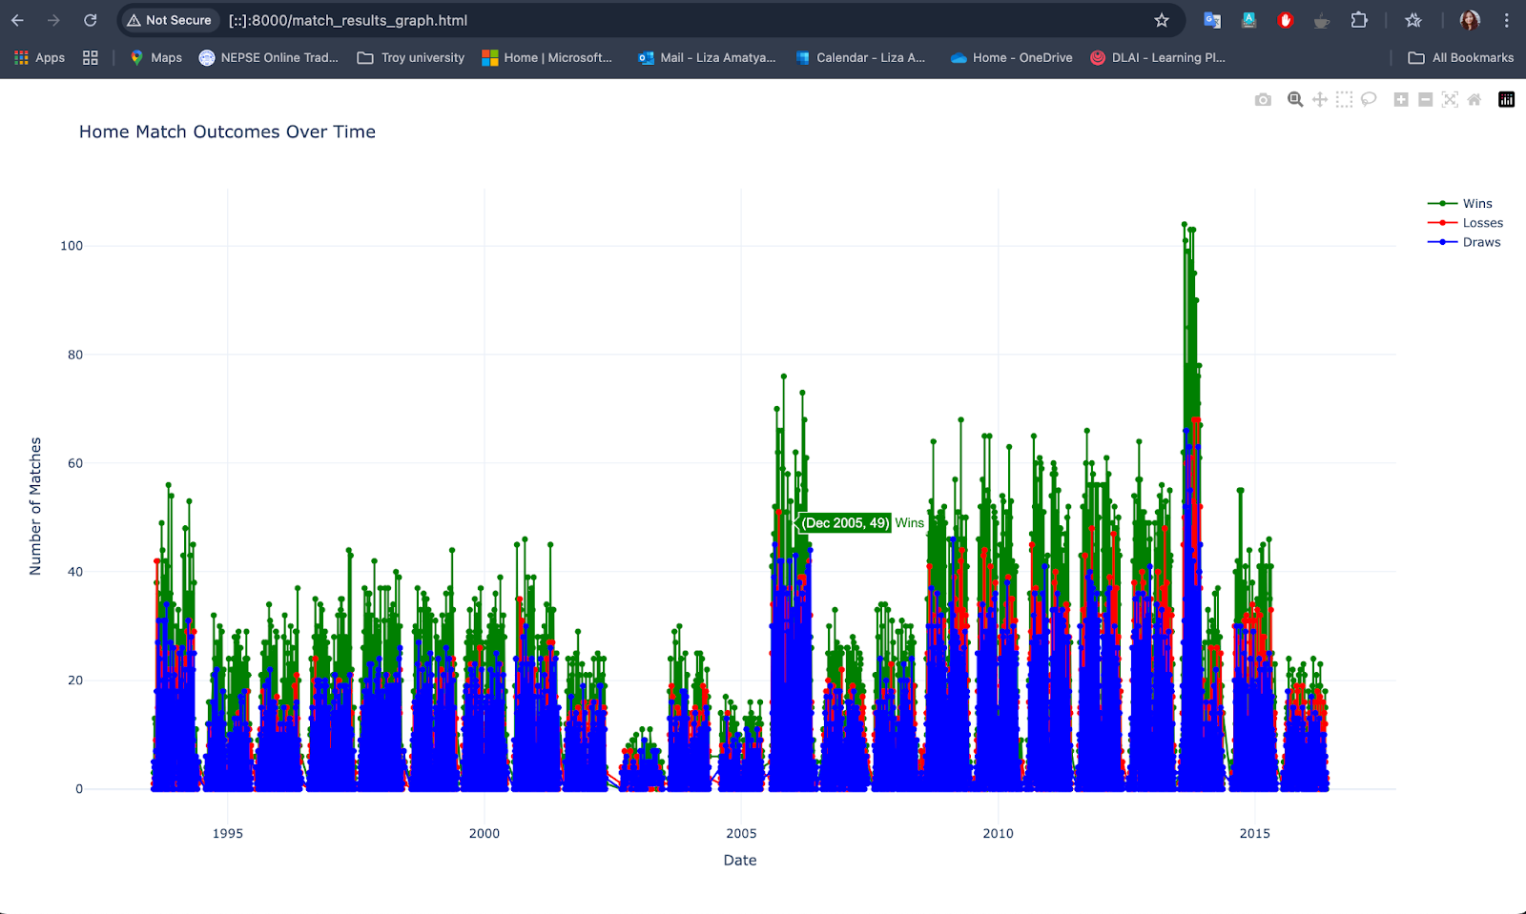
Data Visualization & Analysis
http://18.223.11.133:8080/index.html

Slide 15
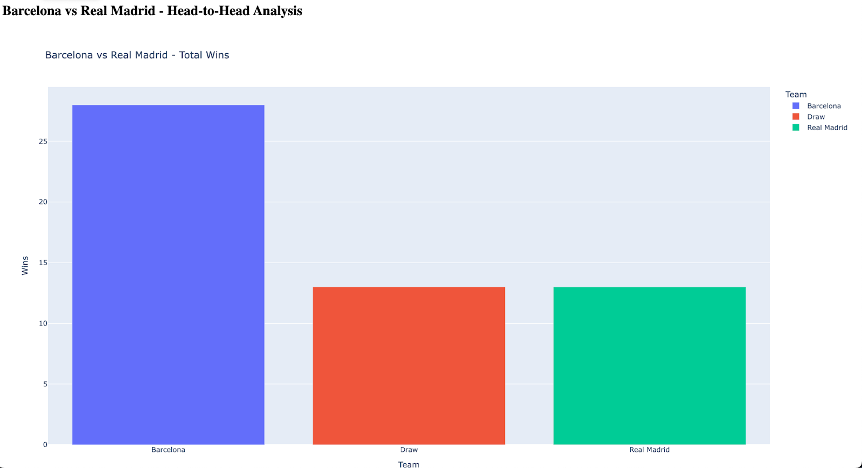
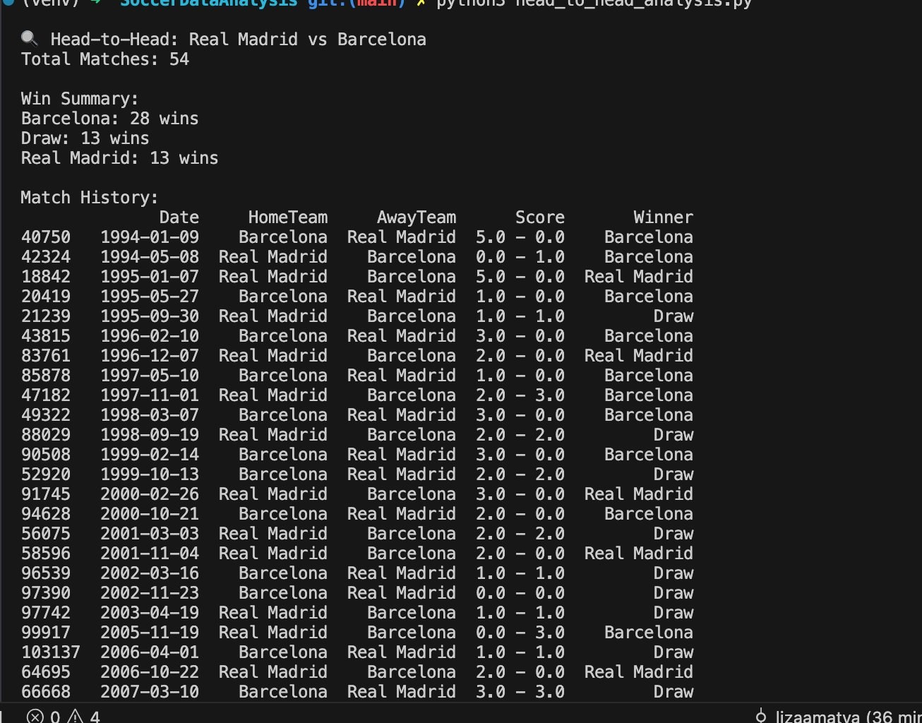
Data Visualization & Analysis

Slide 16
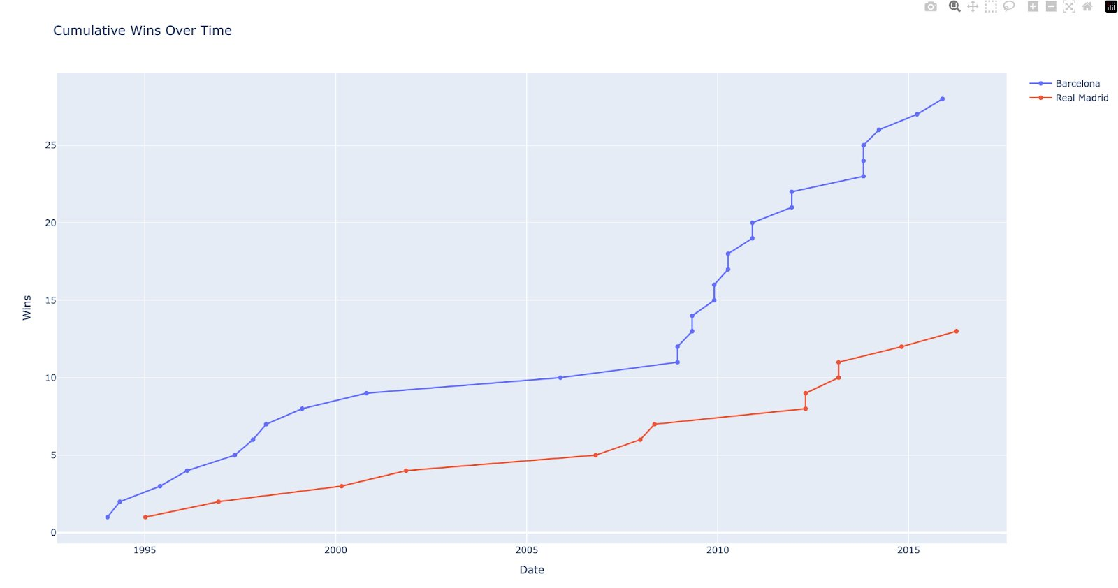
Data Visualization & Analysis

Slide 17
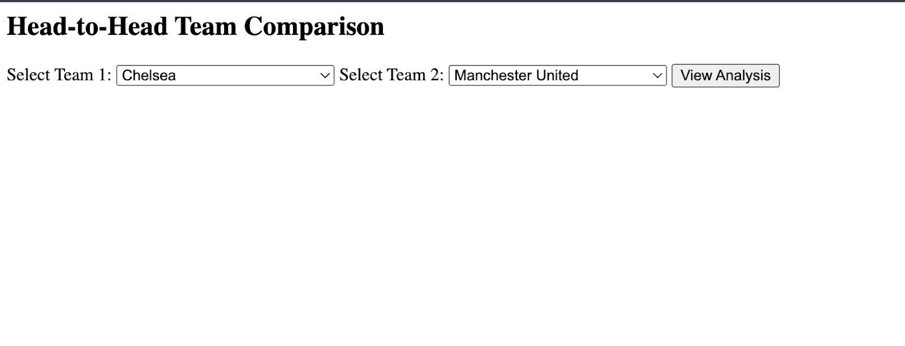
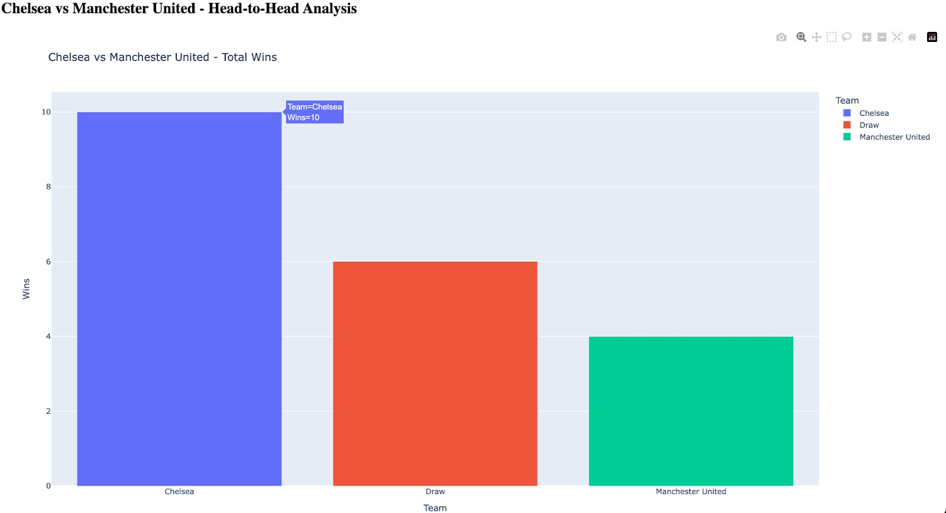
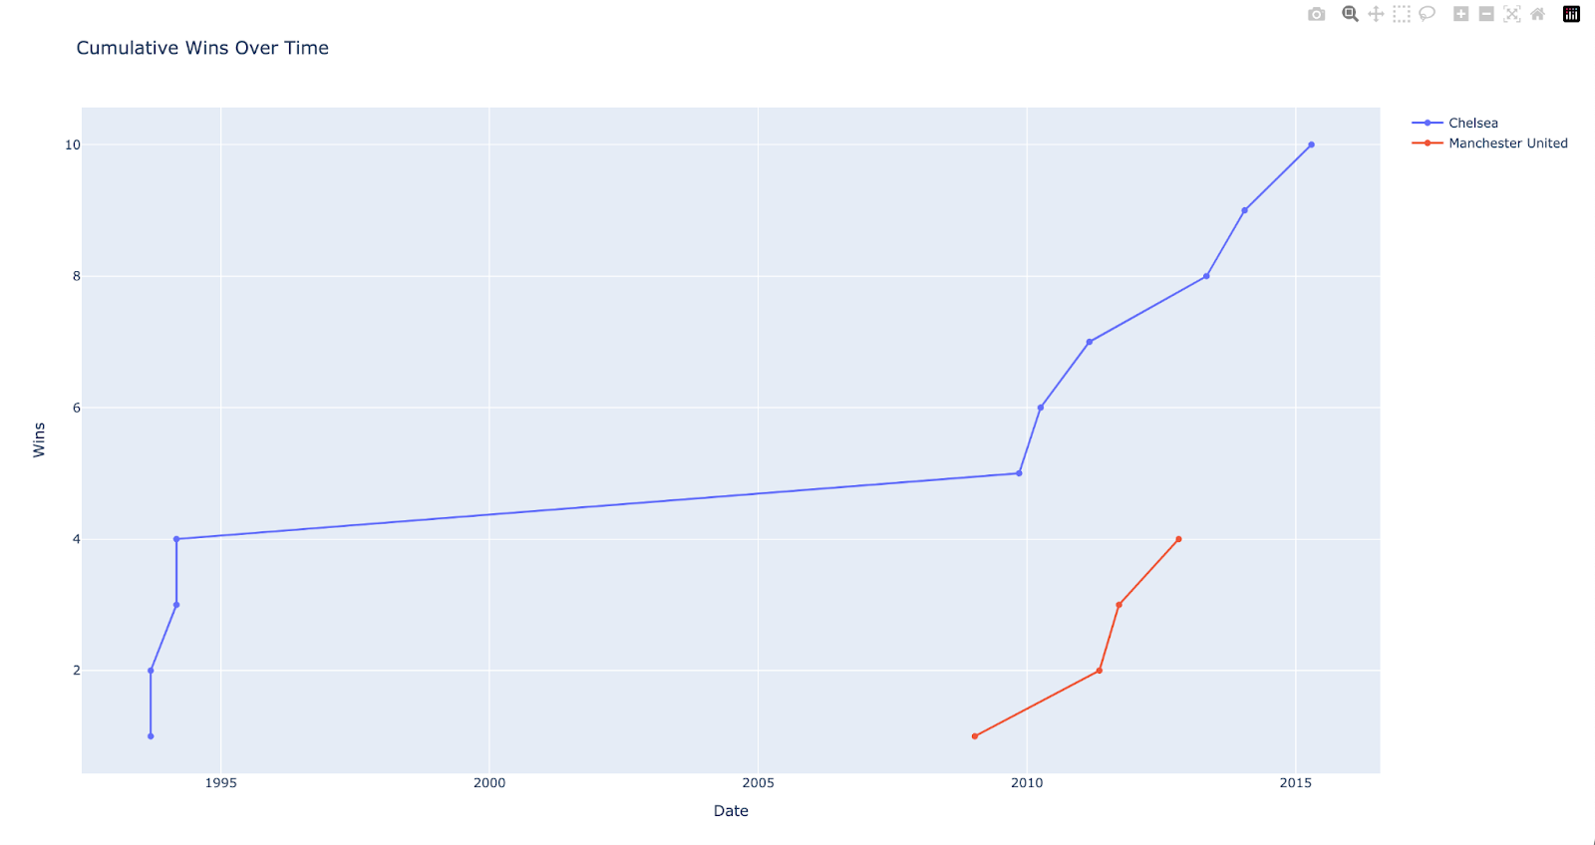
Data Visualization & Analysis

Slide 18
Superset Integration
Installed in virtualenv on Doris FE EC2
Connected via SQLAlchemy
URI: mysql://root:@<FE_IP>:9030/master_football_data
Created charts:
Time-series line chart (results over time)
Stacked bar chart (win/loss/draw by year)
Pie chart (win percentage by team)
Enabled SQL Lab for custom analysis

Slide 19
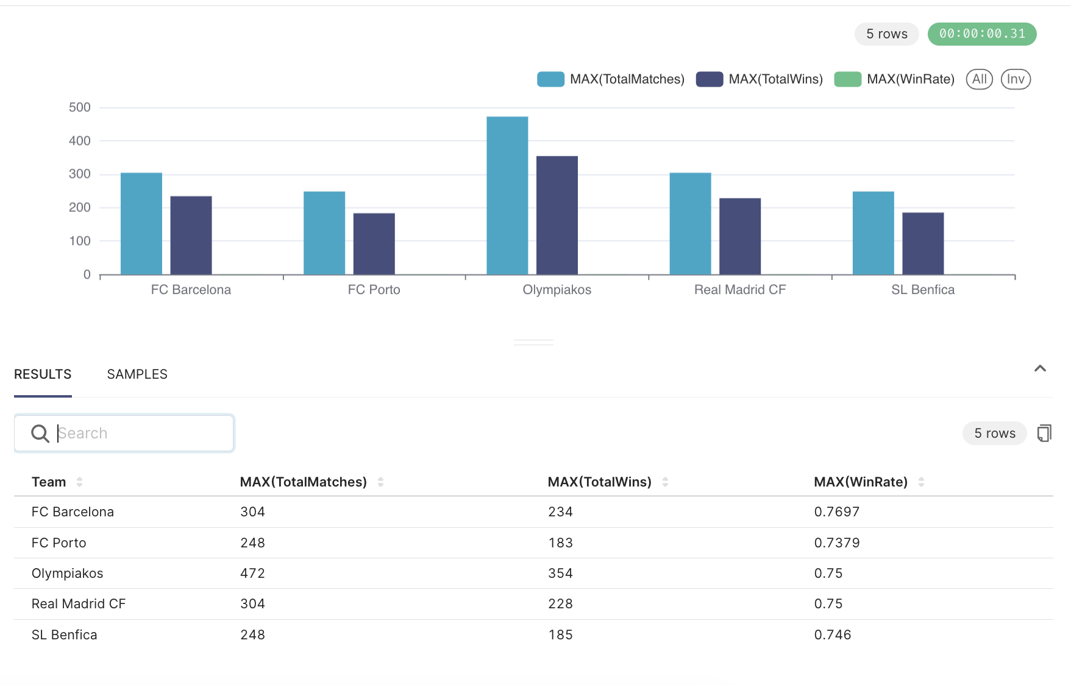
Comparative Analysis of Top 5 Teams
Olympiakos leads in both matches (472) and wins (354) with a strong 75% win rate.
FC Barcelona shows the highest win rate (76.97%), winning 234 of 304 matches.
Real Madrid CF matches Barcelona in games played but slightly lags in win rate.
SL Benfica edges FC Porto in both wins and win rate despite identical match counts.

Slide 20
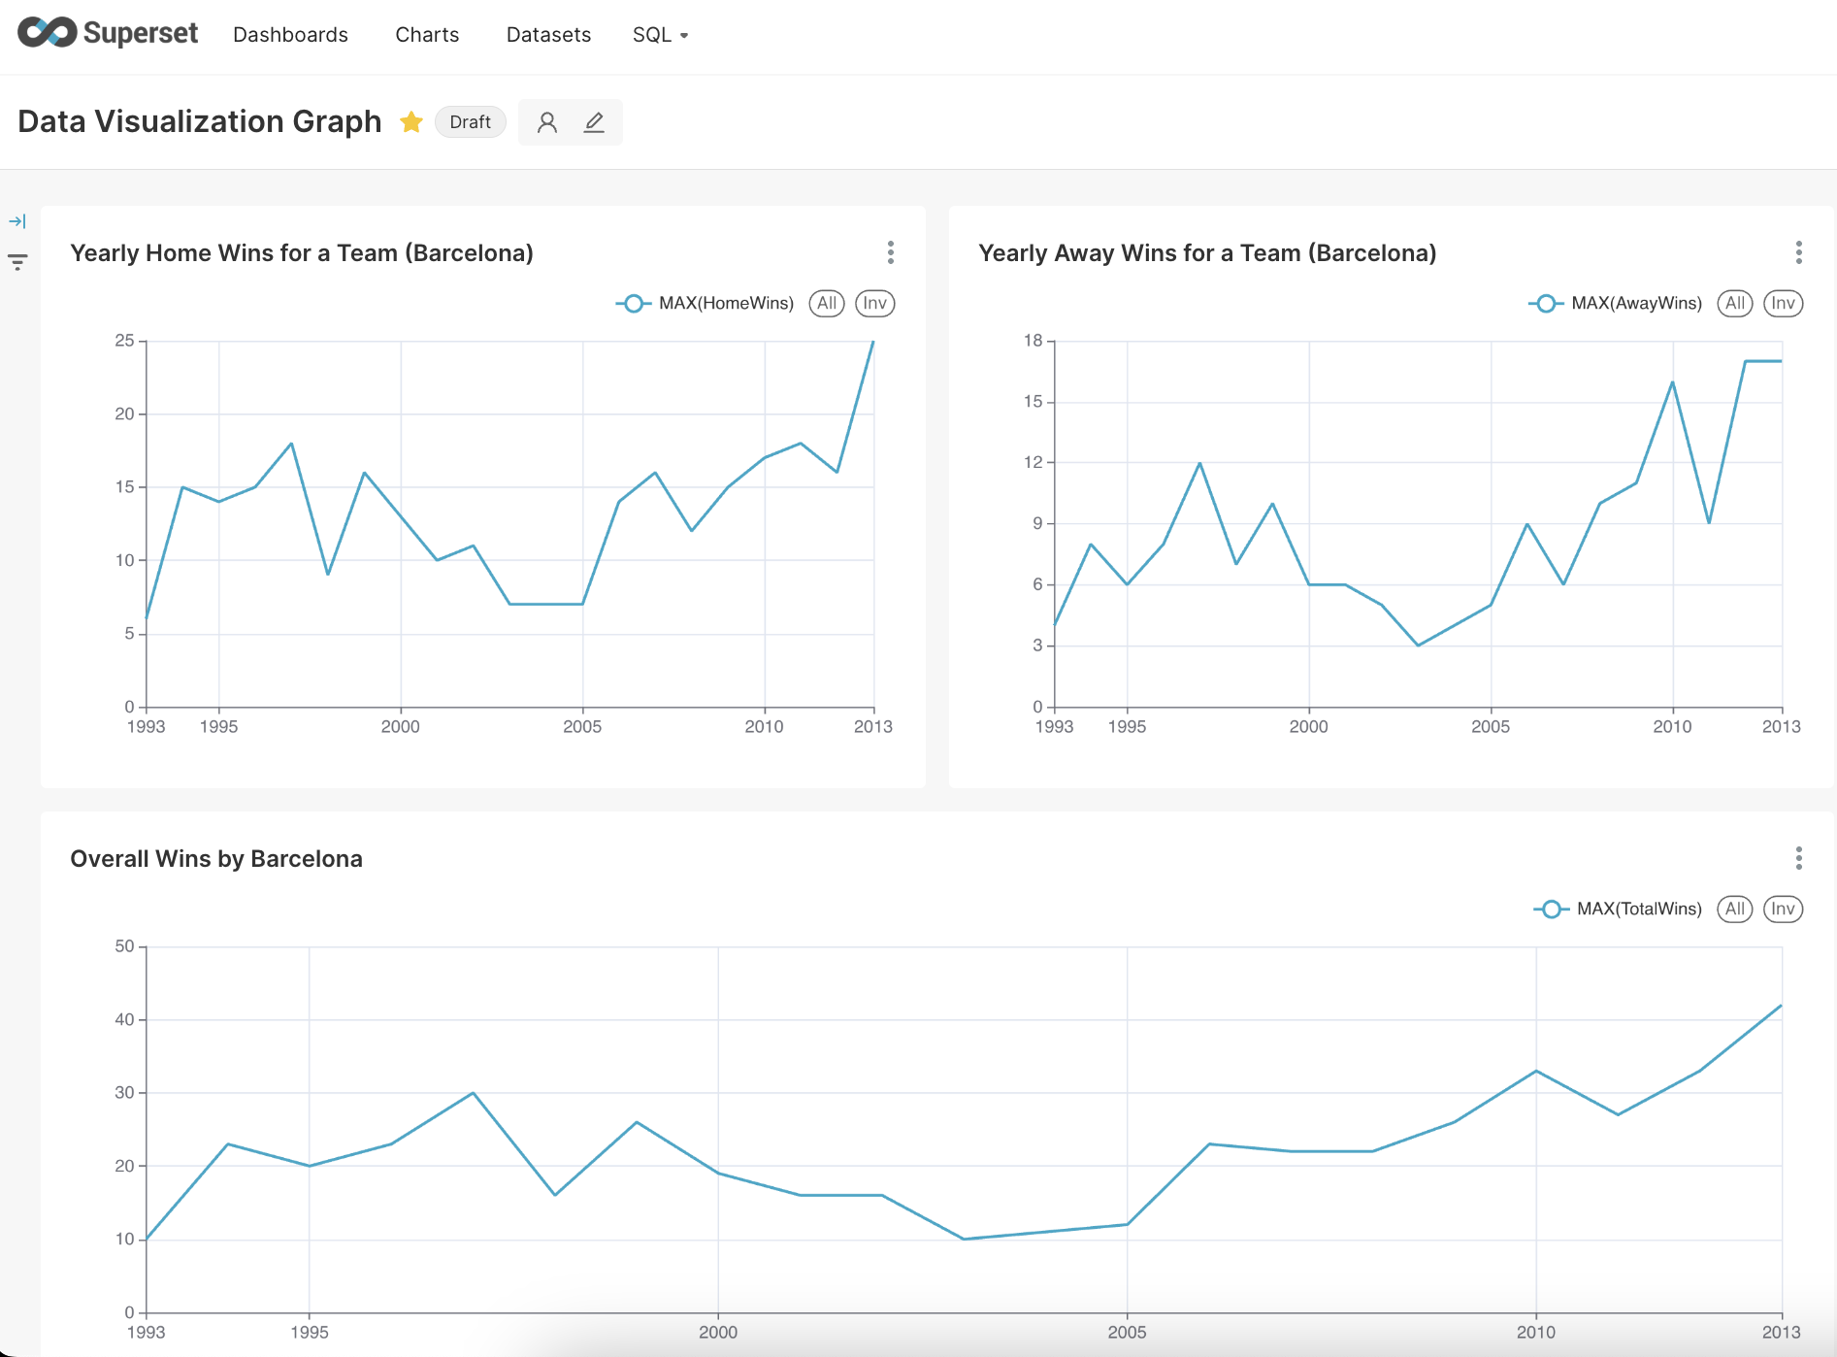
Barcelona Win Trends Over the Years (Home, Away & Total)
• Home Wins: Consistently strong, peaking sharply around 2013. Indicates dominance at home ground throughout the years. • Away Wins: Fluctuating but shows a clear rising trend post-2005, reflecting improved performance on the road. • Total Wins: Gradual upward trajectory over the two decades, highlighting overall team growth and strategic progress.

Slide 21
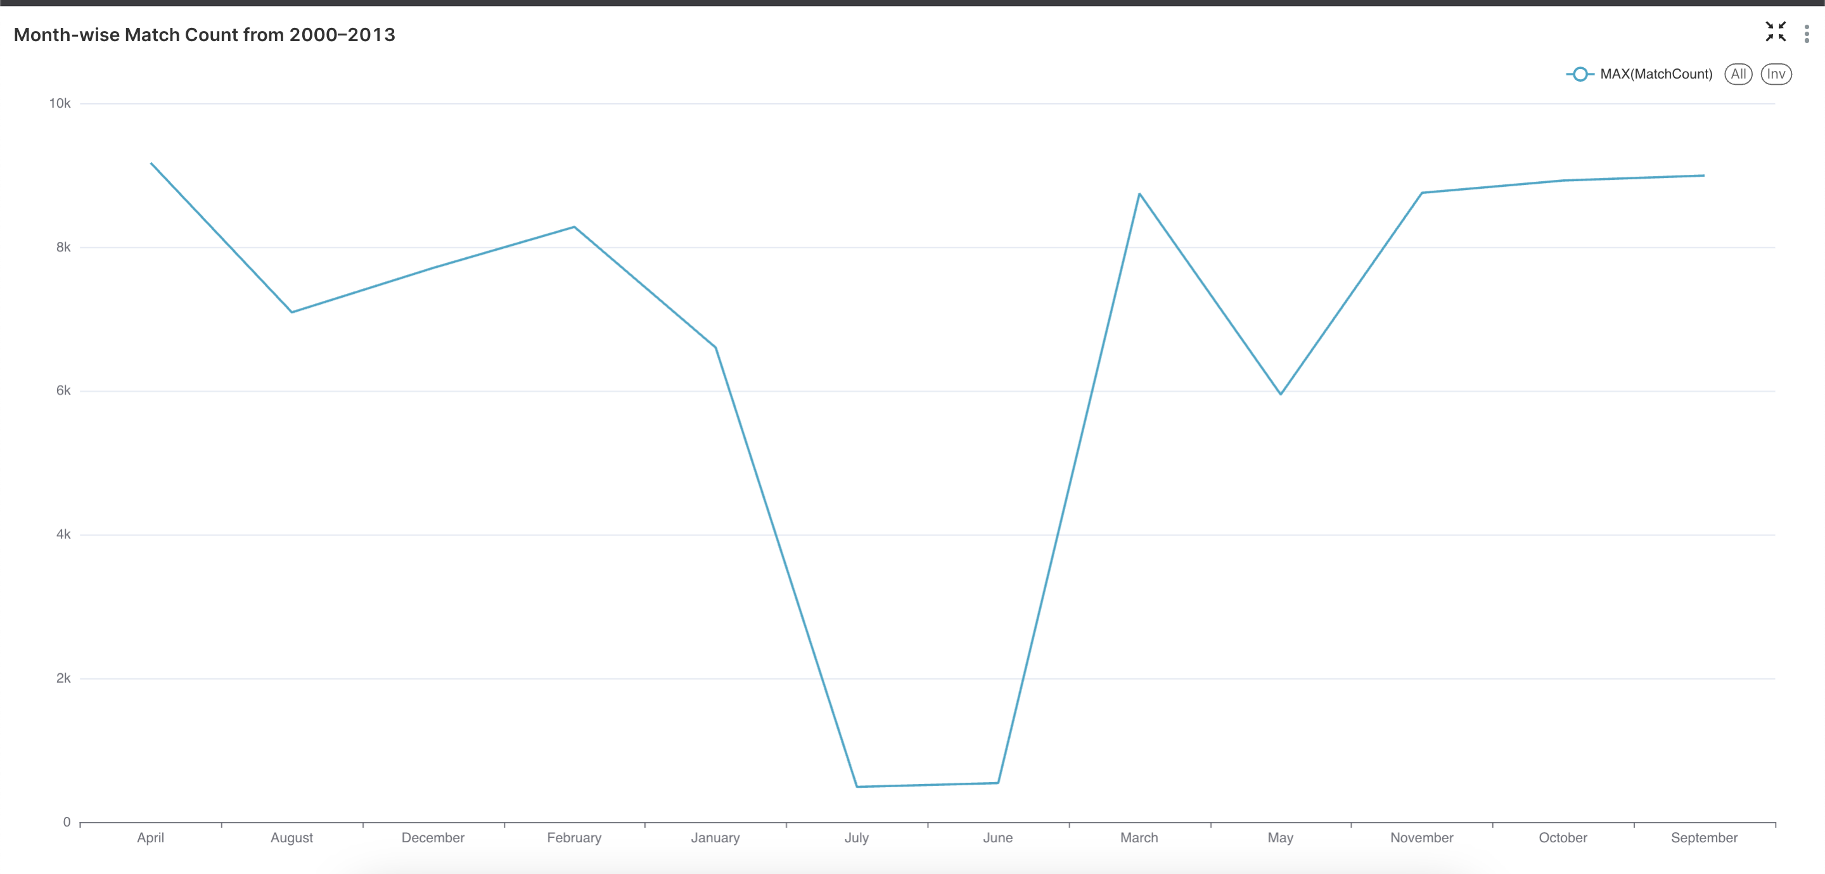
Month-wise Match Count from 2000–2013
Most football matches between 2000–2013 were concentrated in the months of March, April, and October, aligning with peak domestic and international fixtures.
July and June saw the lowest activity, reflecting the global off-season and summer breaks.

Slide 22
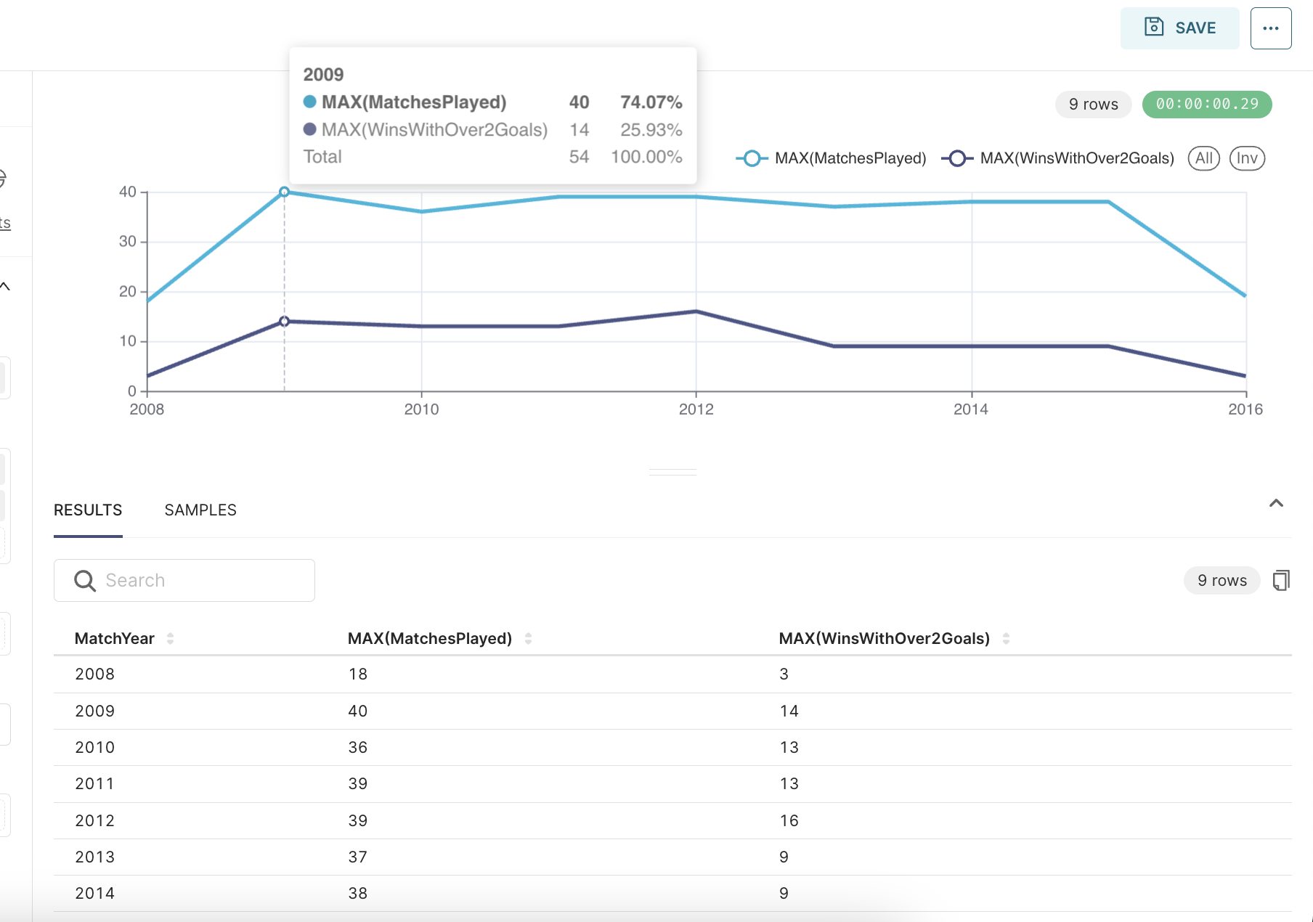
Manchester United – High-Scoring Wins vs. Total Matches (2008–2016)
Manchester United consistently played around 35–40 matches per year from 2009 to 2015.
Peak performance in 2012, securing 16 wins with over 2 goals out of 39 matches.
There was a noticeable decline in high-margin wins after 2012, despite match count staying stable—indicating a dip in offensive dominance.

Slide 23
Future Scope
This uses only historical data, but can also be used for real-time or recent game data
Can be used to predict game outcomes in real time
Can be extended to even analyze player position and gaming strategies for different teams
Not only club games, but analyze international games like FIFA World Cup
Visualise Worldcup matches in map chart.

Slide 24
Thank you

